Slide 1
New Credit Card Fraud Detection System
:- By Krishna Pachori

Slide 2
Problem Statement:
Suppose you are part of the analytics team working on a fraud detection model and its cost-benefit analysis. You need to develop a machine learning model to detect fraudulent transactions based on the historical transactional data of customers with a pool of merchants.
Approach:
The approach to the problem can be divided into below parts:
Data Understanding, Data Preparation and EDA
Model Selection and Model Building
Model Evaluation
Cost-Benefit Analysis

Slide 3
Agenda
🞇 Objective
🞇 Background
🞇 Key Insights
🞇 Cost Benefit Analysis
🞇 Appendix:
Data Attributes
Data Methodology
Attached Files

Slide 4
Objective
🞇 Getting in place a credit card fraud detection system to save on incurred costs incurred
🞇 Huge costs are being incurred due to frauds and a manual detection system

Slide 5
Background
🞇 A machine learning model has been built to detect frauds early and mitigate losses
🞇 A cost benefit analysis has been done for the deployment of the same

Slide 6
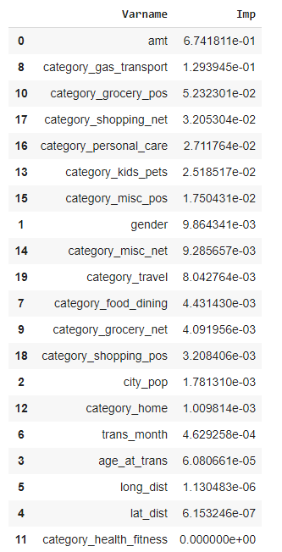
Key Insights
🞇 Transaction amount, category and gender are the most important variables
🞇 Gas and transport, grocery and shopping are the top three categories

Slide 7
Current Incurred Losses
🞇 77,183 credit card transactions per month
🞇 402 fraudulent transactions per month
🞇 $ 530.66 amount per fraud transaction
🞇 Total costs incurred from fraud transactions is $ 213,325.

Slide 8
Business Impact After New Model Deployment
🞇 681 fraudulent transactions detected by the model per month
🞇 $ 1.5 cost to provide customer support to
these transactions that is $ 1021.5 in total
🞇 20 fraudulent transactions not detected by model which amounts to $ 10613.2 loss
🞇 Total cost incurred after new model deployment is $ 11364.5
🞇 Final savings after new model deployment is
$201960.82 that is reduction in losses by ~94%

Slide 9
Appendix: Data Attributes
🞇 Snapshot of the data:
o index - Unique Identifier for each row
o o o
o o o o o o o o o o o
o o o o o o o o
transdatetrans_time - Transaction DateTime
cc_num - Credit Card Number of Customer
merchant - Merchant Name
category - Category of Merchant
amt - Amount of Transaction
first - First Name of Credit Card Holder
last - Last Name of Credit Card Holder
gender - Gender of Credit Card Holder
street - Street Address of Credit Card Holder
city - City of Credit Card Holder
state - State of Credit Card Holder
zip - Zip of Credit Card Holder
lat - Latitude Location of Credit Card Holder
long - Longitude Location of Credit Card Holder
city_pop - Credit Card Holder's City Population
job - Job of Credit Card Holder
dob - Date of Birth of Credit Card Holder
trans_num - Transaction Number
unix_time - UNIX Time of transaction
merch_lat - Latitude Location of Merchant
merch_long - Longitude Location of Merchant
is_fraud - Fraud Flag <--- Target Class

Slide 10
Appendix: Data Methodology
🞇 A random forest classifier built on top a Kaggle simulated dataset
🞇 Class imbalance adjusted using Adaptive Synthetic (ADASYN) sampling method
🞇 Manual hyperparameter tuning done due to extensive computational times when using Grid Search Cross Validation

Slide 11
Attached Files
🞇 Cost Benefit Analysis:
Cost+Benefit+Analysis by Krishna.xlsx
🞇 Random Forest Classifier Model:
credit card fraud detection by Krishna.ipynb

